Slide 1

Topic G01 Understanding NoSQL database

Slide 2
Understand Nosql Database
CONTENT
Explain advantages and disadvantages of relational database
Explain NoSQL and type of NoSQL databases
Use MongoDB
Explain NoSQL data modeling
Reference:
Dan Sullian, Advanced NoSQL for Data Science (2017), LinkedIn Course
MongoDB documentation, https://docs.mongodb.com/manual/core/data-modeling-introduction/
Notes:
Teaching Tips: Introduce the overall teaching plan and the first chapter

Slide 3
Relational Database - recap
Records are organized into tables.
Rows of tables are identified by keys.
Data spans multiple tables, which are linked by a join operation.
Transactions are ACID-compliant.
Data models are normalized.
3

Slide 4
Atomicity
Each transaction is ‘all or nothing’.
Consistency
Any transaction will bring the database from one valid state to another.
Isolation
The concurrent execution of transactions results in a system state that would be obtained if the transactions were executed serially.
Durability
If part of the transaction fails, then the entire transaction fails.
The database state is left unchanged.
Once transaction has been committed, it will remain so.
It satisfies all the rules and constraints that database.

Slide 5
Relational Database
Advantages
Comprehensive querying
Normalized data
Widely supported
Disadvantages
Fixed schema
Costly to join
Limited data structures
Difficult to scale

Slide 6
Relational Database – minimize the cons
Denormalization
Expand the number of columns in a single table
Partition
Breaking up the database and store pieces of database in different servers
Replication
Making copies of the database, store the copies in different servers

Slide 7
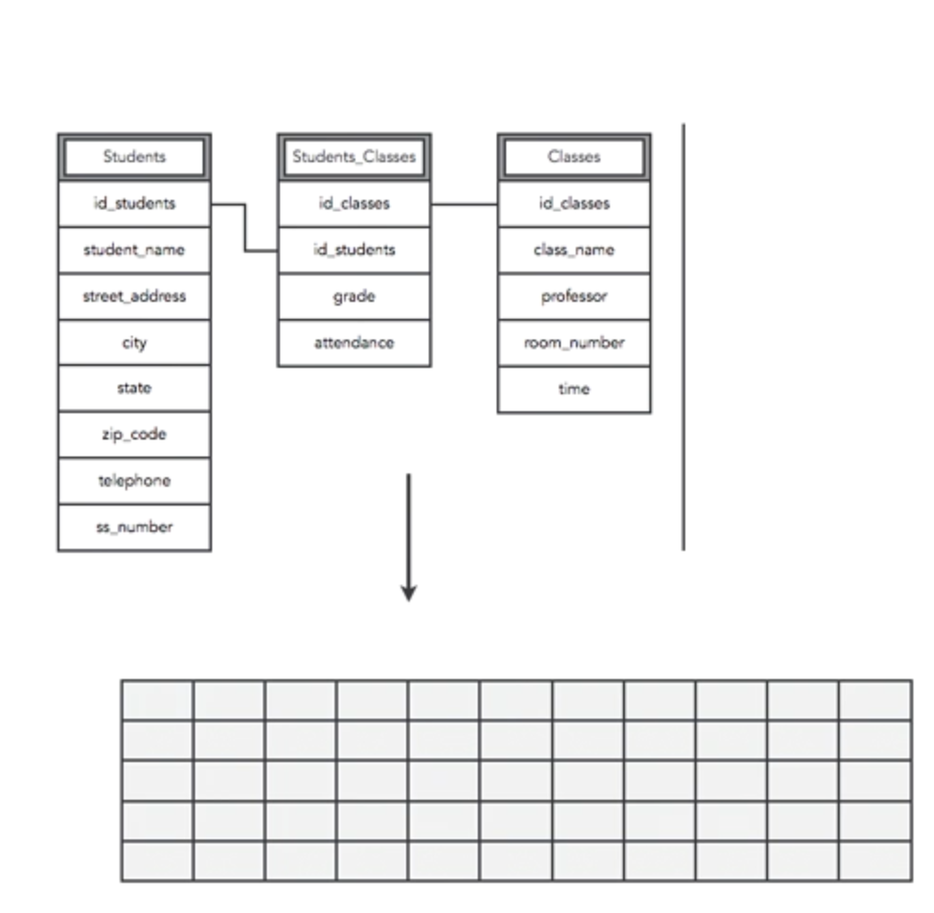
Relational Database – minimize the cons
Denormalization
Avoid joins
Expand the number of columns
Design table to include related data
Query a single table
Improve read performance

Slide 8
What is NOSQL Database?
Not using SQL
Flexible Schema
No fixed-table definition
Fields are not standardized between records
Support complex data structures
Nested values are common in NoSQL database
Design with ‘partition’ in mind (Scalability)
8

Slide 9
NOSQL Database Type
Key-value (eg Amazon S3)
Based on key-value or dictionary data structures
Document (eg CouchDB, MongoDB)
Multiple key-value pairs in a document
Wide Column (eg Cassandar, Google Bigtable)
Organized in tables, rows and columns
Columns are not fixed, can be different between rows and can be changed
Graph (Neo4j)
Network of connected entities
Entities are linked by edges
9

Slide 10
Short QUIZ
Which type of NoSQL database is based on sets of nodes and edges between nodes?
(Choose: Document, Wide-Column, Graph)
Which is not an advantage of NoSQL database?
(Choose: Support ‘Joins’, Support for large dataset, Support distributed database)
10

Slide 11
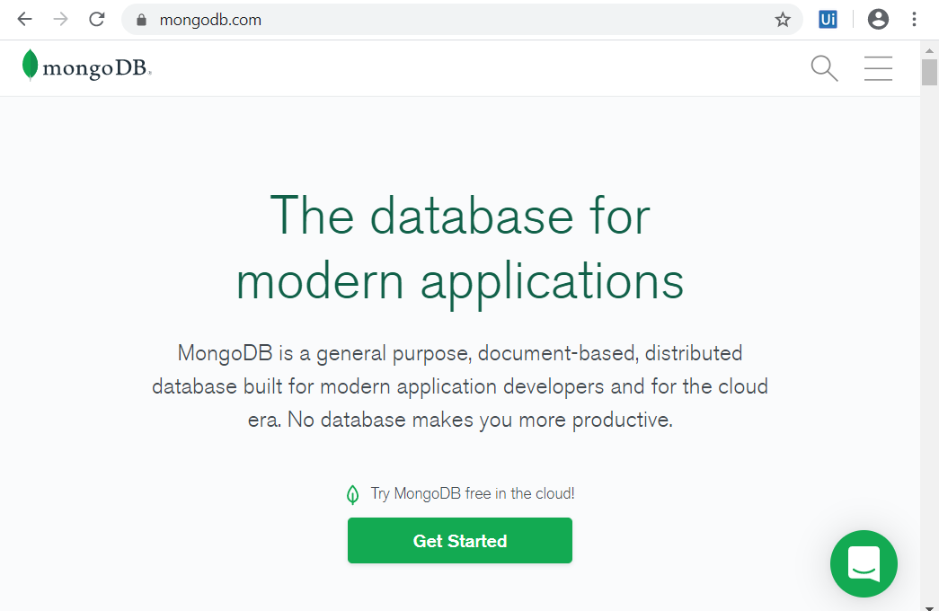
Notes:
Accessed on 26 Dec 2019
Teaching Tips: Highlight that MongoDB is an example of document-based NoSQL database

Slide 12
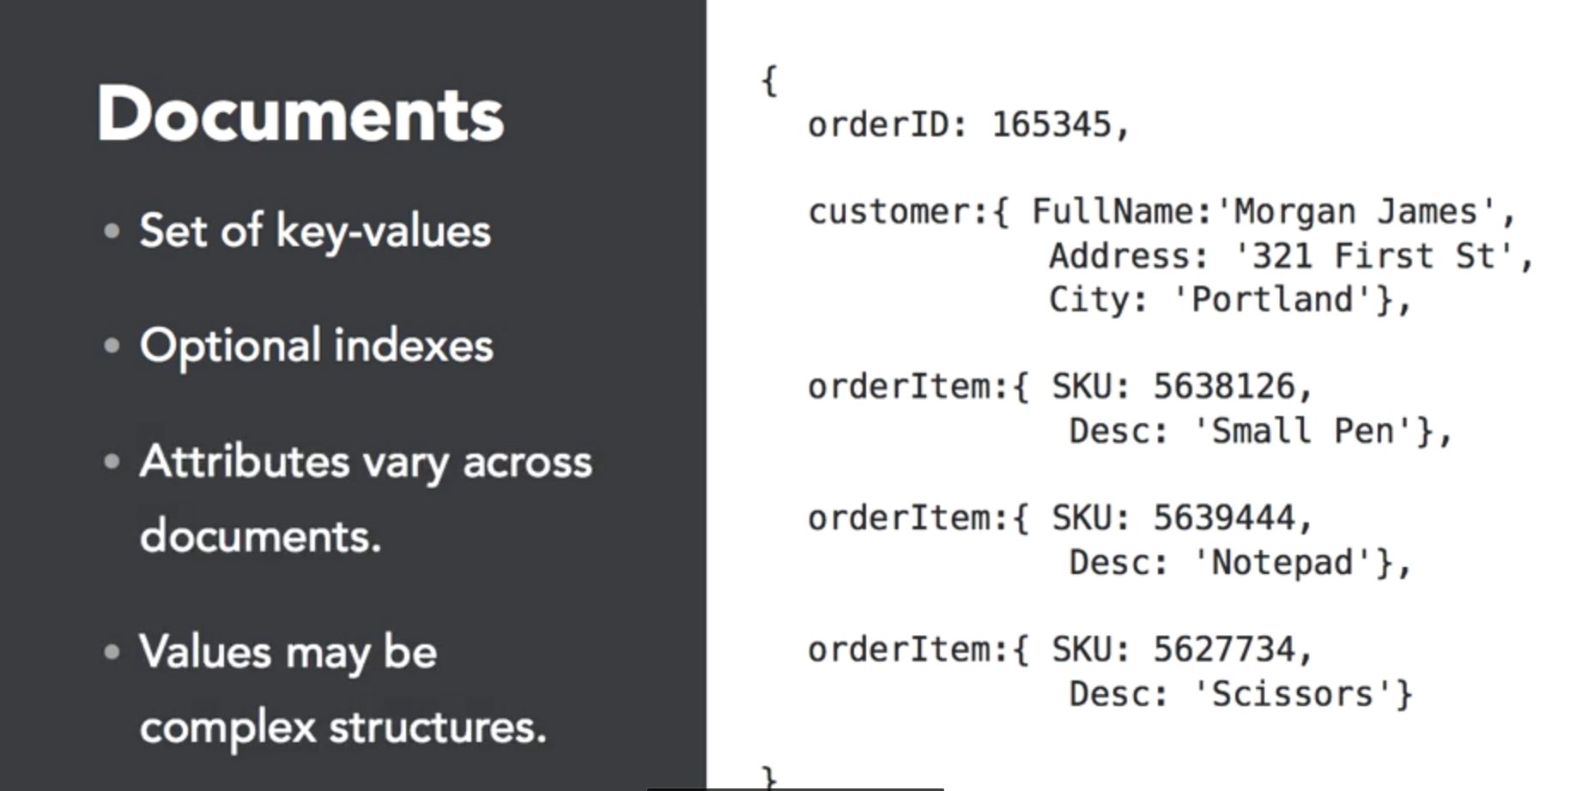
Document data model – Document (~ RECORD)
12

Slide 13
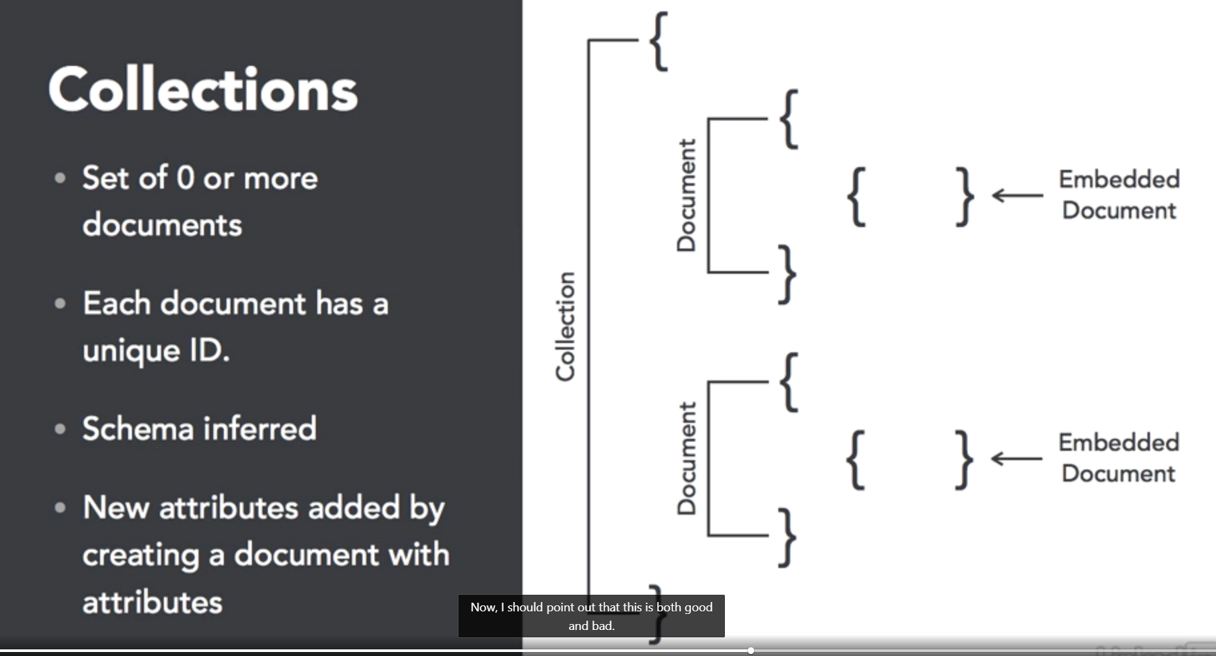
DOCUMENT data model – Collection (~ Table)
13

Slide 14
Run MongoDB Community Edition
Set up Mongo Environment
Create \data\db
Start MongoDB
Run mongod.exe
Connect to MongoDB via Mongo Shell
Run mongo.exe
If not using default dbpath, specify --dbpath actualpath
14
Notes:
https://docs.mongodb.com/manual/tutorial/install-mongodb-on-windows/#run-mongodb-community-edition

Slide 15
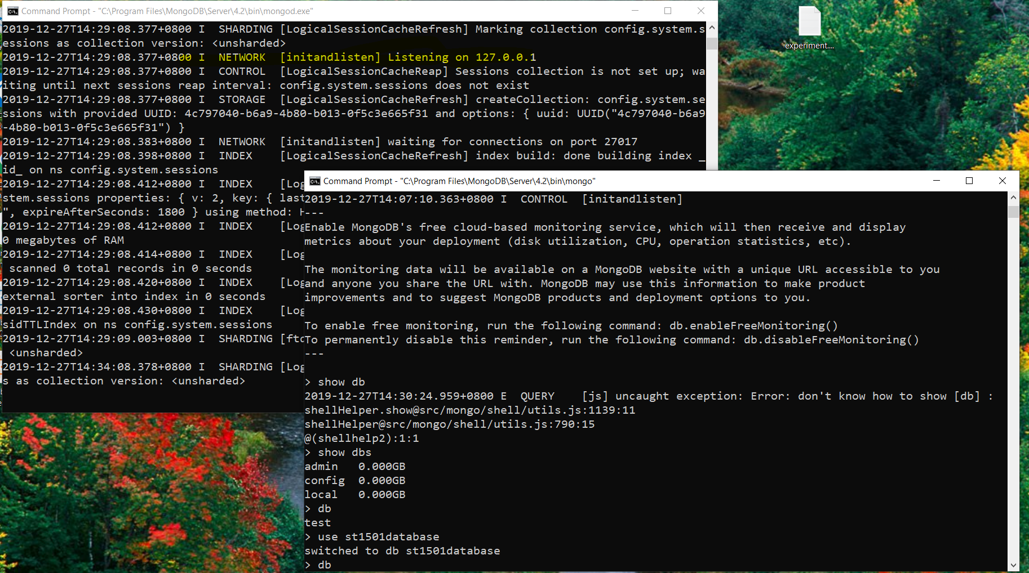
Run MongoDB Community Edition
15
Notes:
Teaching Tips: Highlight there is two windows, one is running mongod.exe, another
https://docs.mongodb.com/manual/tutorial/install-mongodb-on-windows/#run-mongodb-community-edition

Slide 16
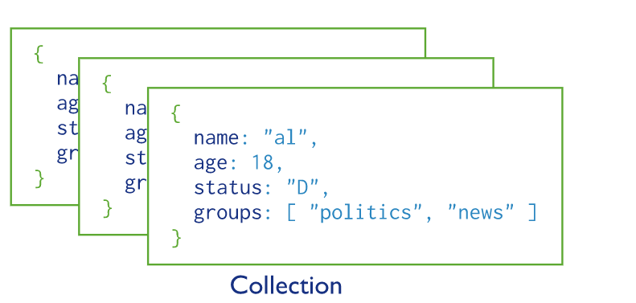
MongoDB: Database & Collection
MongoDB stores JSON documents in collection, collections in database.
16

Slide 17
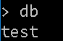
Display the current database
Using NoSQL (MongoDB)
To display the database you are using, type db
db

Slide 18
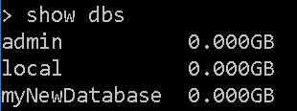
List available databases
Using NoSQL (MongoDB)
To list the available databases, type ‘show dbs’
show dbs

Slide 19
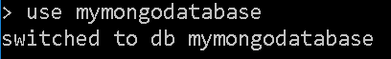
Switch to a different database
Using NoSQL (MongoDB)
To switch databases, issue the use command
If the database does not exist, it will be created
use mymongodatabase

Slide 20
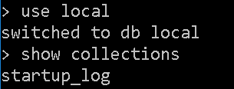
List collections in current db
Using NoSQL (MongoDB)
To see the list of collections in the current database, use the ‘show collections’ command:
show collections

Slide 21
MongoDB CRUD Operations

Slide 22
Create Operations
Using NoSQL (MongoDB)
Create or insert operations, add new documents to a collection.
If the collection does not currently exist, insert operations will create the collection.
MongoDB provides the following methods to insert documents into a collection.
db.collection.insertOne()
db.collection.insertMany()
Notes:
https://docs.mongodb.com/manual/crud/#create-operations
https://docs.mongodb.com/manual/tutorial/insert-documents/

Slide 23
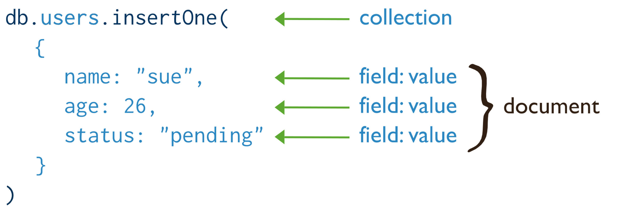
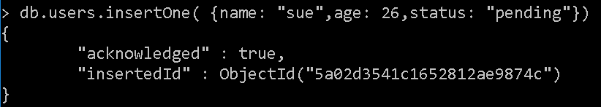
Create Operations
Using NoSQL (MongoDB)
Notes:
https://docs.mongodb.com/manual/crud/#create-operations
https://docs.mongodb.com/manual/tutorial/insert-documents/

Slide 24
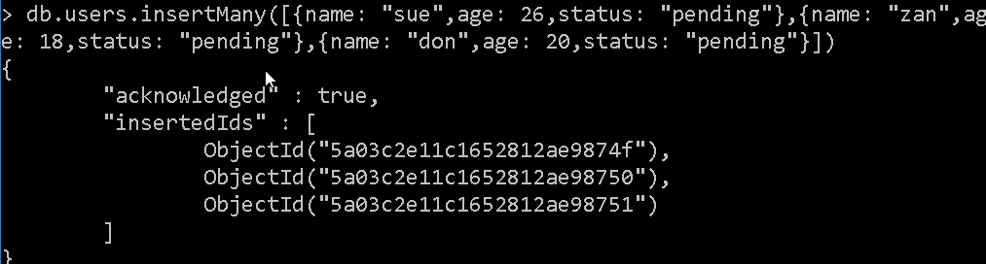
Create Operations (insertOne)
Using NoSQL (MongoDB)
db.users.insertOne({name: "sue",age: 26,status: "pending"})
Notes:
https://docs.mongodb.com/manual/crud/#create-operations
https://docs.mongodb.com/manual/tutorial/insert-documents/

Slide 25
Create Operations (insertMany)
Using NoSQL (MongoDB)
db.users.insertMany([{name: "sue",age: 26,status: "pending"},{name: "zan",age: 18,status: "pending"},{name: "don",age: 20,status: "pending"}])
Notes:
https://docs.mongodb.com/manual/crud/#create-operations
https://docs.mongodb.com/manual/tutorial/insert-documents/

Slide 26
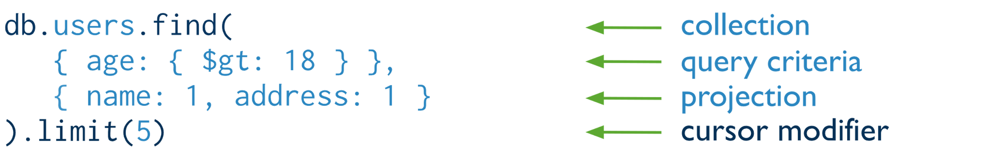
Read Operations
Using NoSQL (MongoDB)
Read operations retrieves documents from a collection; i.e. queries a collection for documents.
MongoDB provides the following methods to read documents from a collection
db.collection.find()
You can specify query filters or criteria that identify the documents to return
Notes:
https://docs.mongodb.com/manual/crud/#read-operations
https://docs.mongodb.com/manual/tutorial/query-documents/

Slide 27
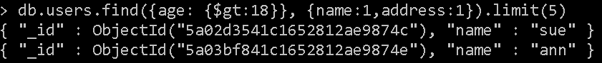
Read Operations
Using NoSQL (MongoDB)
db.user.find({gender: "female"}, {name:1}).limit(5)
db.users.find({age: {$gt:18}}, {name:1,address:1}).limit(5)
Notes:
https://docs.mongodb.com/manual/crud/#read-operations
https://docs.mongodb.com/manual/tutorial/query-documents/

Slide 28
Update Operations
Using NoSQL (MongoDB)
Update operations modify existing documents in a collection.
MongoDB provides the following methods to update documents of a collection
db.collection.updateOne()
db.collection.updateMany()
db.collection.replaceOne()
In MongoDB, update operations target a single collection.
All write operations in MongoDB are atomic on the level of a single document.
You can specify criteria, or filters, that identify the documents to update.
These filters use the same syntax as read operations.
Notes:
https://docs.mongodb.com/manual/crud/#update-operations
https://docs.mongodb.com/manual/tutorial/update-documents/

Slide 29
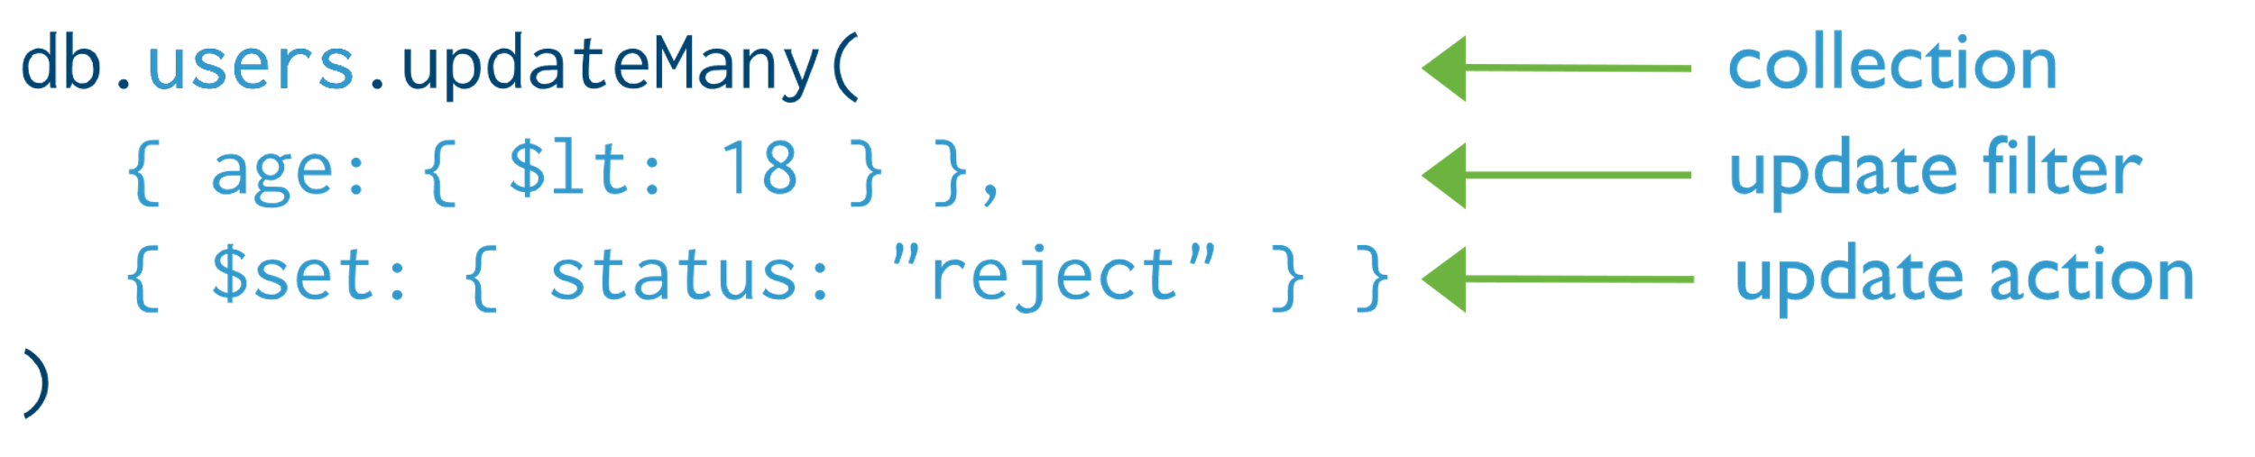
Update Operations
Using NoSQL (MongoDB)
Notes:
https://docs.mongodb.com/manual/crud/#update-operations
https://docs.mongodb.com/manual/tutorial/update-documents/
db.users.updateMany({}, {$set: {status: 'pending'}})

Slide 30
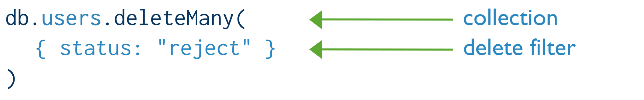
Delete Operations
Using NoSQL (MongoDB)
Delete operations remove documents from a collection.
MongoDB provides the following methods to delete documents of a collection:
db.collection.deleteOne()
db.collection.deleteMany()
In MongoDB, delete operations target a single collection.
All write operations in MongoDB are atomic on the level of a single document.
You can specify criteria, or filters, that identify the documents to remove
These filters use the same syntax as read operations.
Notes:
https://docs.mongodb.com/manual/crud/#delete-operations
https://docs.mongodb.com/manual/tutorial/remove-documents/

Slide 31
Delete Operations
Using NoSQL (MongoDB)
db.users.deleteOne({name:"sue"})
Notes:
https://docs.mongodb.com/manual/crud/#delete-operations
https://docs.mongodb.com/manual/tutorial/remove-documents/

Slide 32
NoSQL Data Modeling

Slide 33

MONgodb data modeling
MongoDB’s document need not have the same schema.
The document structure can be updated, such as add new fields, remove existing fields, or change the field values to a new type.
Each field can be a complex structure.
Data models for MongoDB applications revolves around the structure of documents.
Embedded Data Model (Denormalized)
Reference Data Model (Normalized)
33

Slide 34
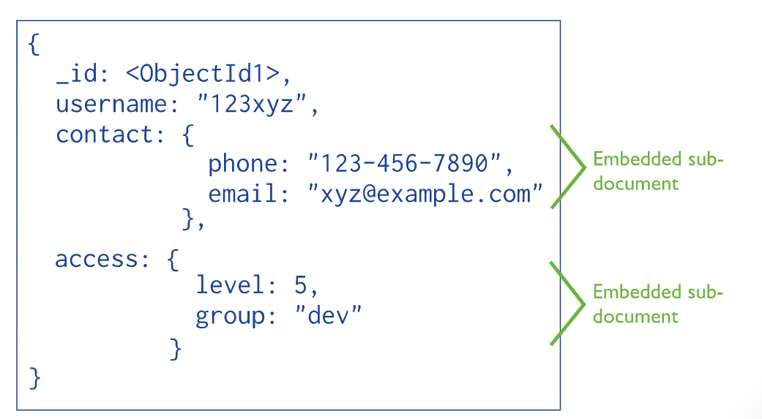
Mongodb data modelling : Embedded data model
Store related piece of information in the same document, result in less quires.
Appropriate:
we have “contains” relationships between entities.
we have one-to-many relationships between entities. In these relationships the “many” or child documents always appear with or are viewed in the context of the “one” or parent documents.

Slide 35
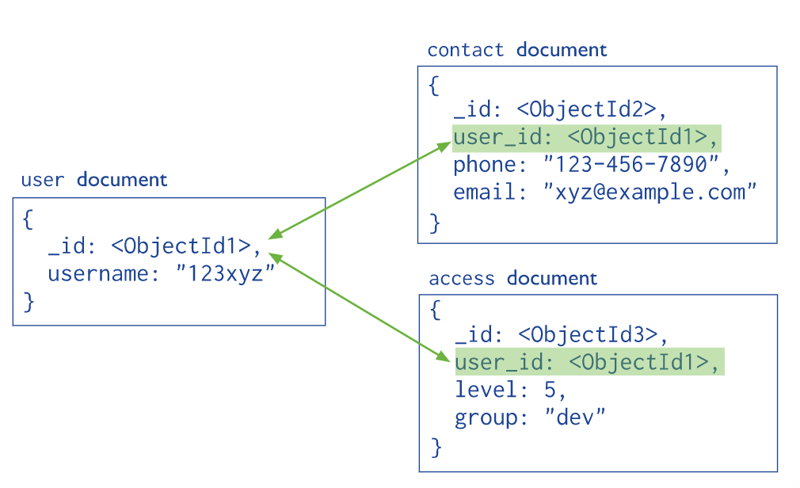
Mongodb data modelling : Reference data model
Store the relationships between data by including links or references from one document to another.
Appropriate:
when embedding would result in duplication of data but would not provide read performance advantages to outweigh the implications of the duplication.
to represent more complex many-to-many relationships.
to model large hierarchical data sets.

Slide 36
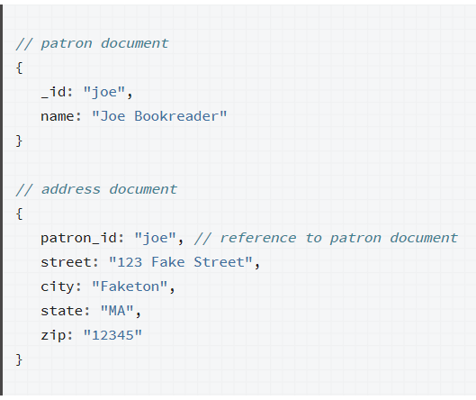
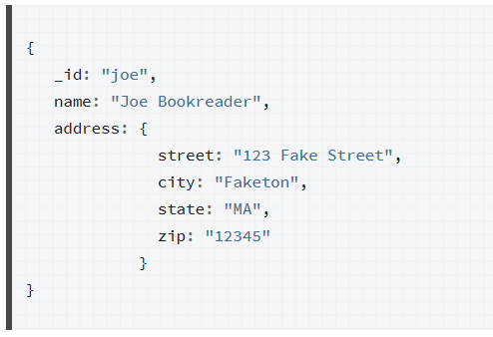
CASE: ONE-to-ONE mapping (EMBEDED)

Slide 37
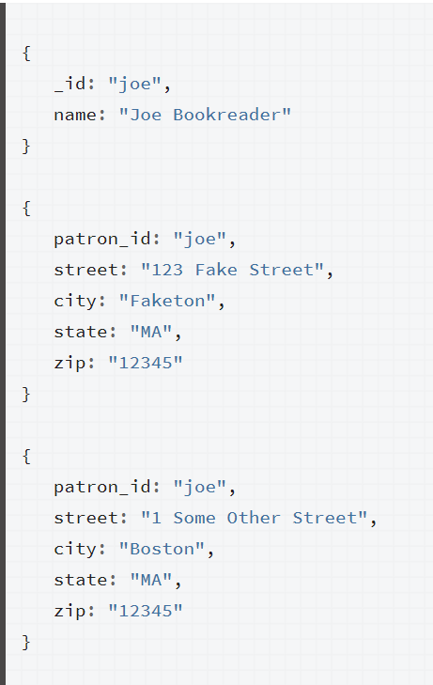
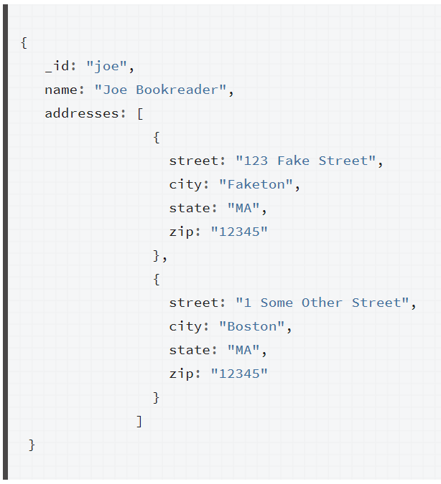
CASE: ONE-to-MANY mapping (EMBEDED)

Slide 38
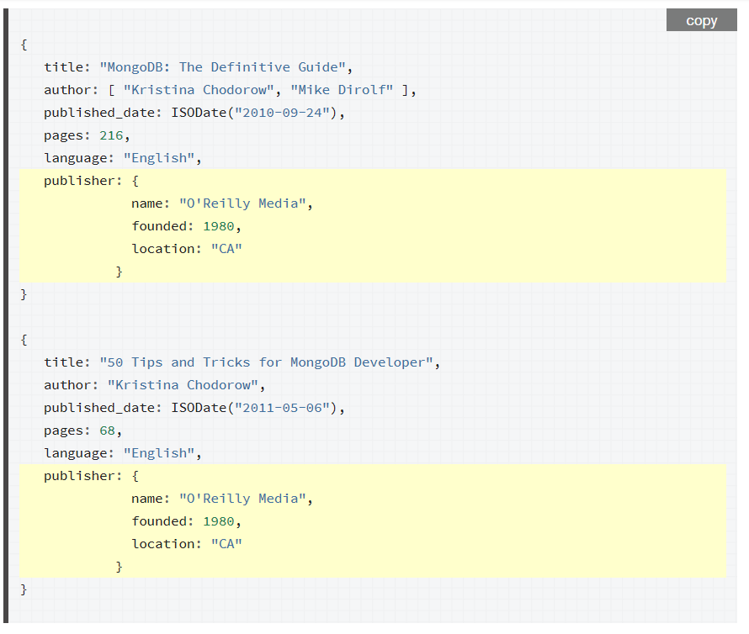
CASE: ONE-TO-MANY
Notes:
Teaching Tip: Use the example to discuss which ‘reference’ module is better. We will go for Solution B

Slide 39
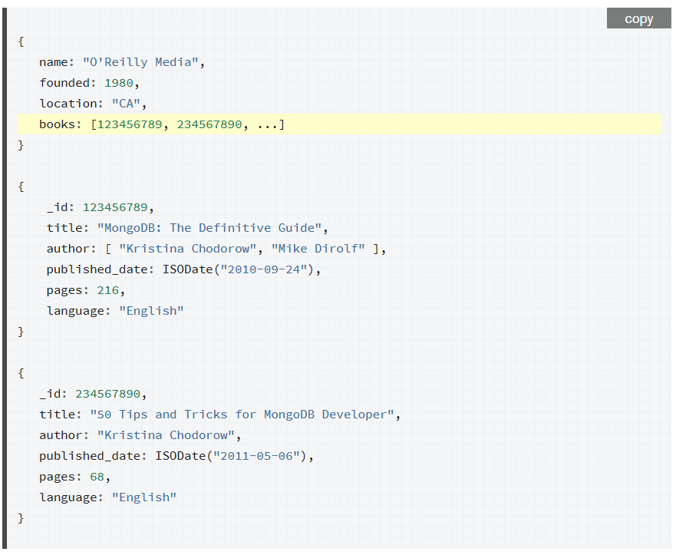
CASE: ONE-TO-MANY Proposed Solution A
Notes:
Teaching Notes:
When using references, the growth of the relationships determine where to store the reference. If the number of books per publisher is small with limited growth, storing the book reference inside the publisher document may sometimes be useful. Otherwise, if the number of books per publisher is unbounded, this data model would lead to mutable, growing arrays, as in the following example:

Slide 40
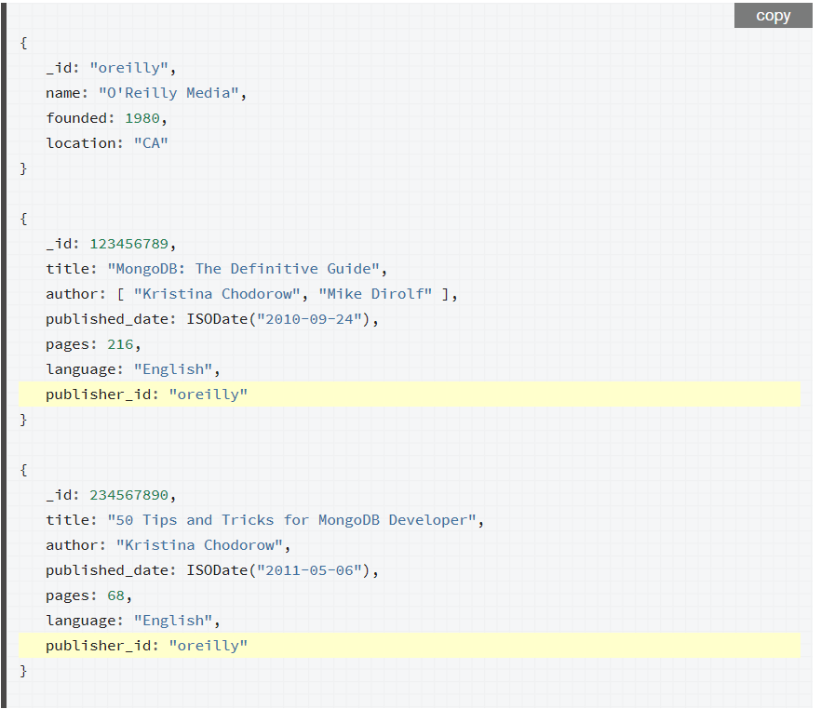
CASE: ONE-TO-MANY Proposed Solution B
Notes:
Solution B:
To avoid mutable, growing arrays, store the publisher reference inside the book document:

Slide 41
MONGodb data modeling: embedded vs reference
Data that is reference together should be embedded.
Dependent entities can be embedded.
Entities with one-to-one relationship can be embedded.
Entities updated at the same time can be embedded.
Independent entities should be reference.

Slide 42
THE END

